Slide 1

Capital One Air | Project Elevate
Scope: Strategic Entry into the U.S. Domestic Aviation Market Objective: Launch 5 High-Priority Round-Trip Routes with Punctuality as Core Value
Presented by : Uma Shankar

Slide 2
Analyze Data and Provide Insights
The 10 busiest round-trip routes in terms of number of round-trip flights in the quarter. Exclude canceled flights when performing the calculation.
The 10 most profitable round-trip routes (without considering the upfront airplane cost) in the quarter. Along with the profit, show total revenue, total cost, summary values of other key components and total round-trip flights in the quarter for the top 10 most profitable routes. Exclude canceled flights from these calculations.​
The 5 round trip routes that you recommend to invest in based on any factors that you choose.​
The number of round trip flights it will take to breakeven on the upfront airplane cost for each of the 5 round trip routes that you recommend. Print key summary components for these routes.
Key Performance Indicators (KPI’s) that you recommend tracking in the future to measure the success of the round trip routes that you recommend.

Slide 3
Datasets
Data Quality Assurance
Data Filtering and Restrictions
Limitations
Flights, Tickets, Airport Codes: Key datasets analyzed for insights into operational and market dynamics.
Validation: Ensured all columns contain intended values, addressing discrepancies promptly.
Formatting: Corrected data types to align with analytical requirements.
Outliers: Retained outliers for comprehensive analysis of operational performance and anomalies.
Missing Values: Applied robust imputation strategies, using medians for numeric columns to maintain dataset integrity.
Data Integrity: Removed invalid strings, ensuring datasets consist only of valid airport codes.
Duplicates: Eliminated duplicate entries across all columns to prevent data redundancy and ensure accuracy.
Focused Analysis: Filtered out cancelled flights, non-round trips, and non-US airports to tailor analysis to the US domestic market.
Data Linkage: Acknowledged challenges in linking tickets to their corresponding flights due to inherent data limitations, potentially impacting comprehensive analysis and insights.
Data Preparation & Quality for BI (Cleansing, Transformation, and Key Considerations)

Slide 4

Approach towords the solution
Step-by-Step Strategy:
Data Collection & Integration Combined flights, Tickets and Airport Codes datasets.
Data Cleansing & Transformation
Removed nulls, corrected date formats, and standardized airport codes
Calculated derived metrics: delay_rate, profit, occupancy_rate
Considering the US flights data.
Remove Cancelled flights.
Consider only medium_airport and large_airport
Performance Metric Definition Evaluated each route on key metrics:
Punctuality (Delay Rate)
Profitability
Occupancy Rate (Passenger Load Factor)
Fare vs. Distance Efficiency
Decoking Costs
Fuel, Oil, Maintenance, Crew (FOMC) costs per mile
Depreciation, Insurance, Other (DIO) costs per mile
Filtering Criteria for Route Shortlisting
Routes with <20% delay rate
Minimum 70% occupancy rate
Positive net profit margins
Spread across different U.S. regions for geographic balance
Scoring & Ranking Assigned scores to each route using weighted metrics:
40% Punctuality
30% Profitability
20% Occupancy
10% Distance Efficiency

Slide 5
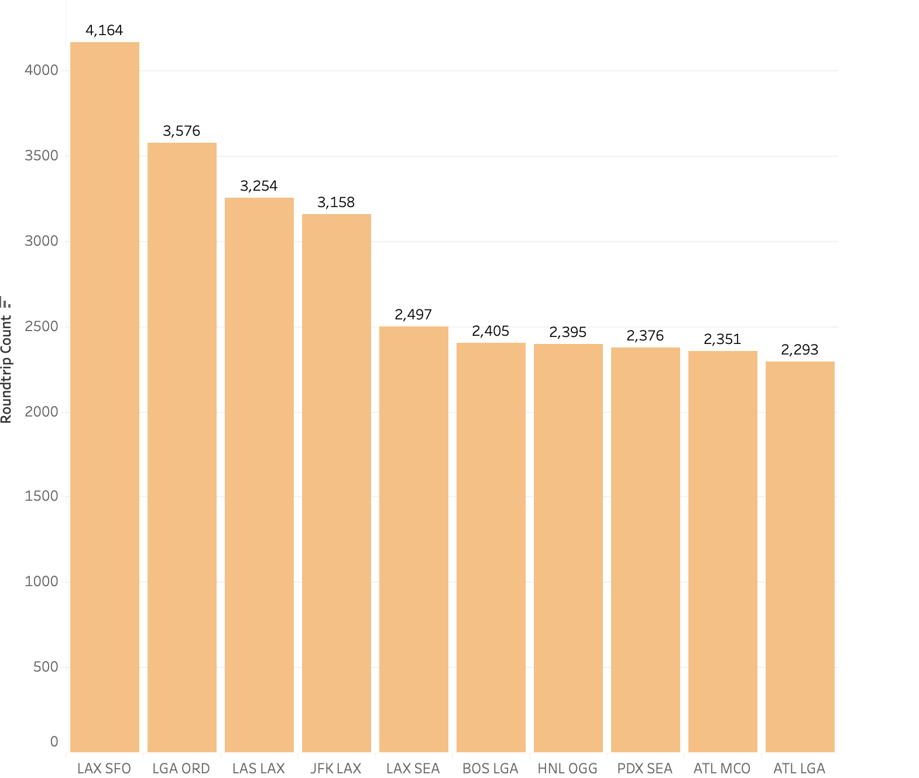
Q1: 10 Busiest Round-Trip Routes
Goal:
Identify routes with the highest number of completed round-trip flights in Q1 2019.
Approach:
Filtered out canceled flights.
Grouped by origin-destination pairs.
Counted completed round trips.
Outcome: Ranked top 10 routes by round-trip frequency.

Slide 6
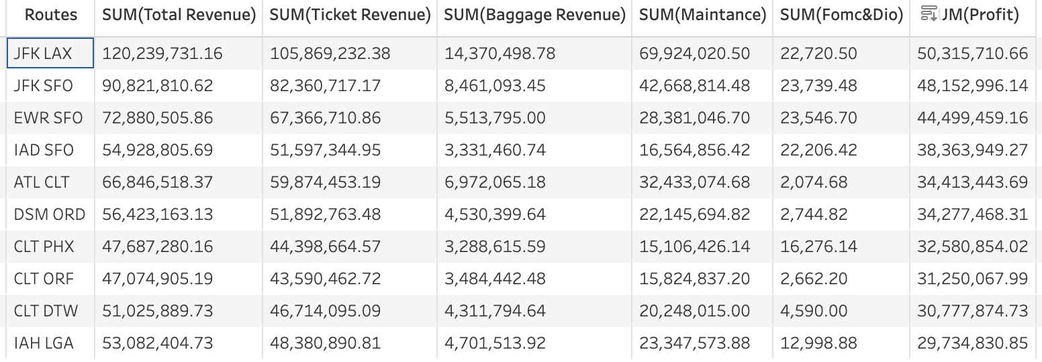
Q2: 10 Most Profitable Routes
Goal: Find routes generating the highest profit (excluding aircraft purchase cost).
Approach:
Excluded canceled flights.
Calculated revenue and costs:
Revenue = Sum of fares × passengers
Costs include: fuel, maintenance, docking, crew, etc.
Profit = Revenue – Total Cost
Summarized key metrics: revenue, cost, profit, flight count, occupancy, delay, etc.
Outcome: Top 10 most profitable routes, with component breakdowns.

Slide 7
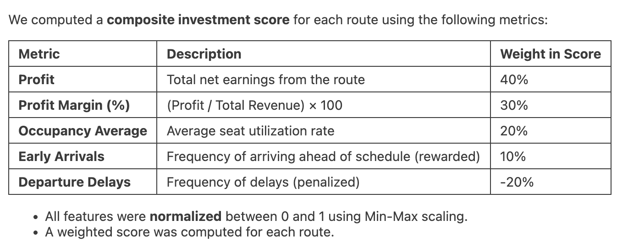
Q3: 5 Recommended Routes to Invest In
Goal: Recommend high-potential routes balancing business and operational efficiency.
Approach:

Slide 8
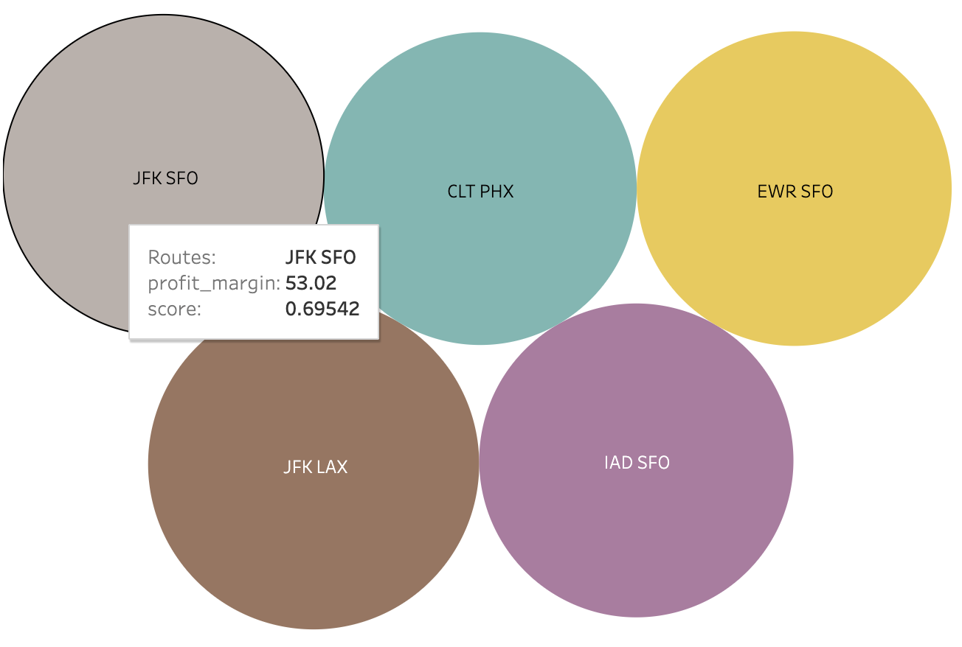
Result:

Slide 9
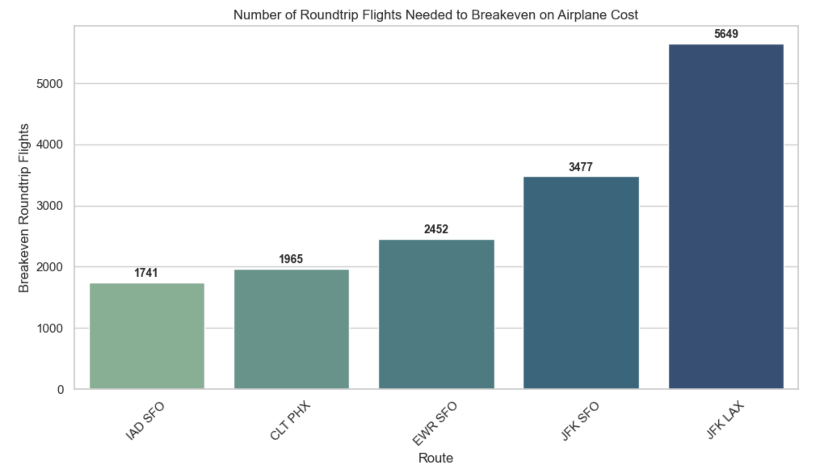
Q4: Breakeven Flights for Upfront Airplane Cost
Goal: Calculate how many round trips are needed to recover the aircraft purchase cost.
Approach:
Use the net profit per round trip for each recommended route.
Divide the airplane purchase cost ($90M per aircraft) by profit per round trip.
Breakeven Flights=Airplane Cost / Profit per Round Trip.

Slide 10
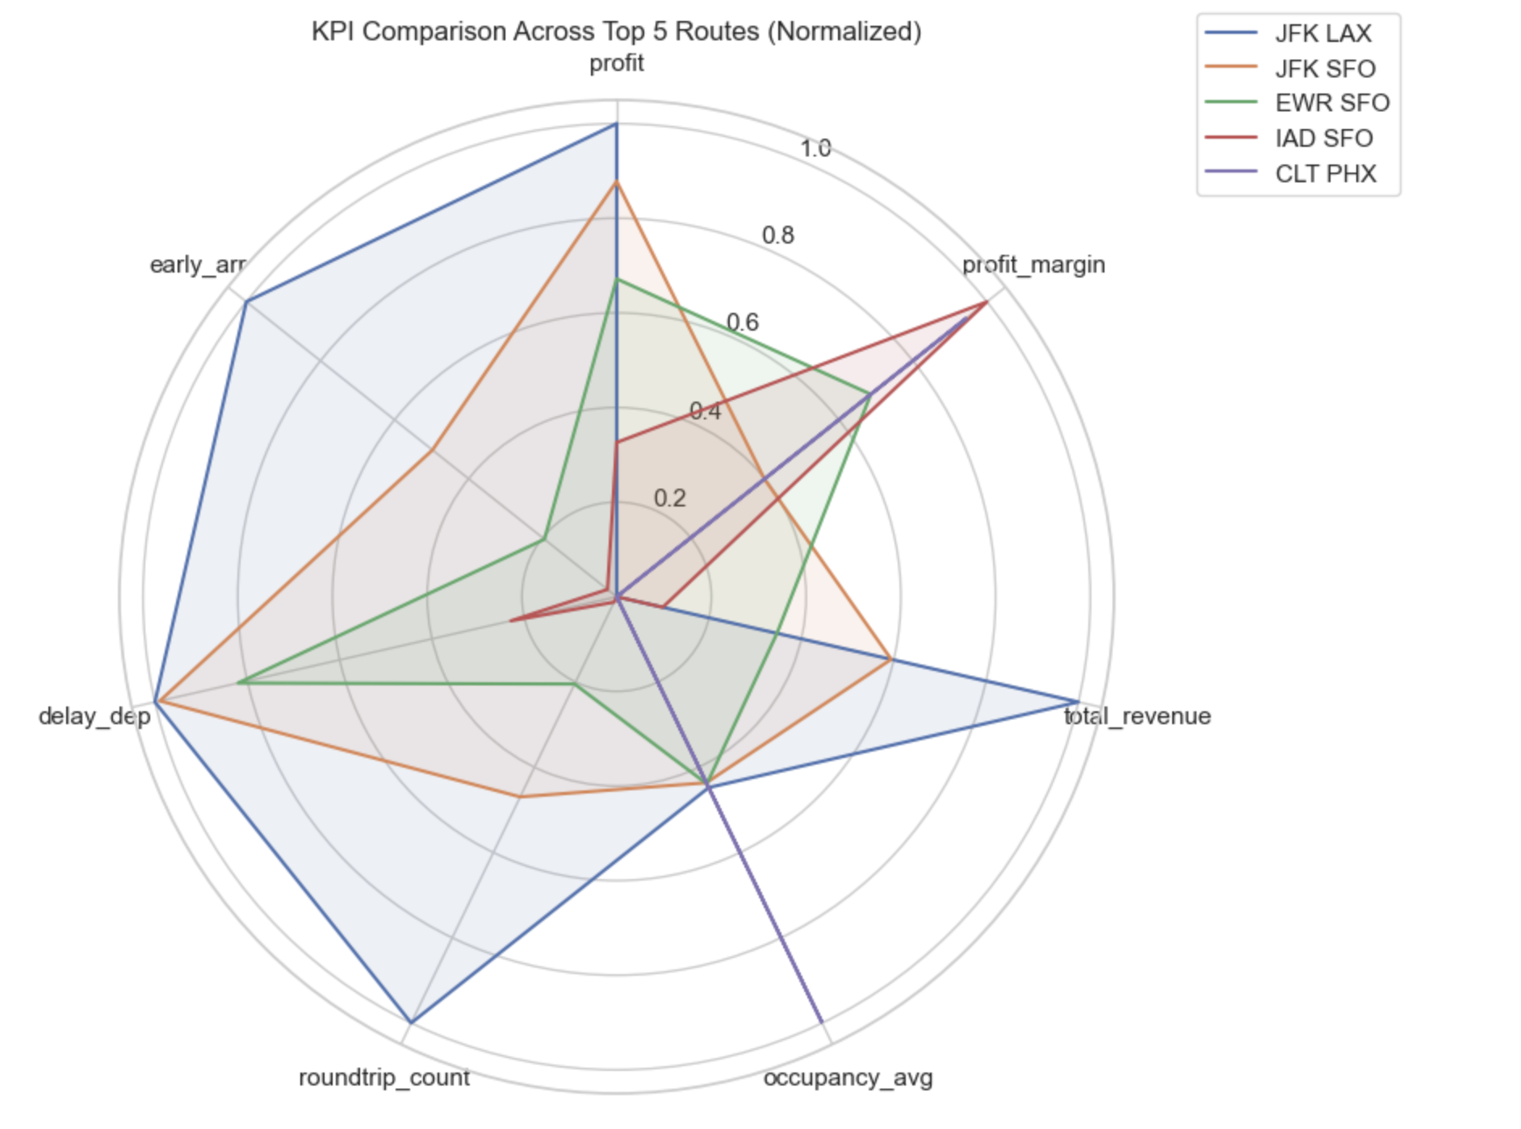
Track high-impact metrics to ensure each route is profitable, efficient, and aligned with our promise: “On time, for you.”
💰 Financial Performance
Profit Measures the absolute earnings per route.
Profit Margin Indicates financial efficiency (Profit ÷ Revenue).
Total Revenue Aggregate income from tickets and services.
⚙️ Operational Efficiency
Occupancy Average
Average % of seats filled — demand indicator
Cost per Mile per Passenger Measures route-level cost efficiency.
Fuel & Maintenance Cost per Route Tracks operational expense trends.
Roundtrip Count Shows flight frequency and market presence.
⏱ Punctuality & Experience
Departure Delay Tracks average departure lag; key for satisfaction and avoid cancellation.
Early Arrivals A positive CX metric; early = delight.

